Slide 1
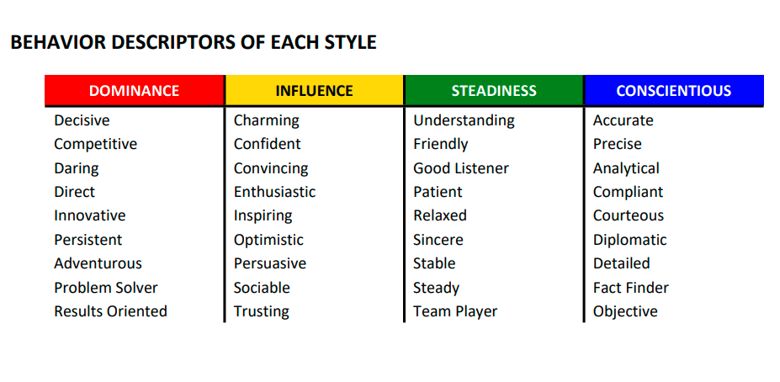
Find your main DISC style | Know the details about your DISC style | Adapt to others’ styles for greater influence
DISC is one of the best communication tools to build rapport with anyone, anywhere and anytime!

Slide 2
